Slide 1
Java Server Pages (JSP) Introduction

Slide 2
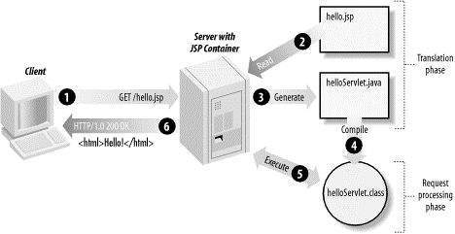
Why JSP?
JSP technology is used to create web application just like Servlet technology
A JSP page consists of HTML tags and JSP tags
Servlet/(Common Gateway Interface) CGI approach
server-side code is a program with HTML embedded
Java Server Page
allows embedding Dynamic Elements in HTML Pages

Slide 3
Advantages of JSP
Extension to Servlet
Can use all the features of servlet
Can use implicit objects, predefined tags, JSTL, expression language and custom tags
Makes application development easy
Easy to maintain
JSP can be easily managed
Easily separate business & presentation logic
Servlet technology
Mix of business logic with the presentation logic

Slide 4
Difference between JSP and Servlet
JSP | Servlet
JSP run slower compared to Servlet as it takes compilation time to convert into Java Servlets | Servlets run faster compared to JSP
It’s easier to code in JSP than in Java Servlets | Its little much code to write here
In MVC, jsp act as a view | In MVC, servlet act as a controller
The advantage of JSP programming over servlets is that we can buildcustom tags which can directly call Java beans | There is no such custom tag facility in servlets

Slide 5
First JSP Program
Index.jsp
<html>
<head><title>JSP Test</title></head>
<body bgcolor="#FDF5E6">
<h1>JSP Test</h1>
</body>
<%out.println(“Welcome to JSP Programming”);
</html>
How to run JSP program?
Copy the program index.jsp in HelloWorld folder
Copy HelloWorld folder in myjsp folder
Keep myjsp folder in webapps
Navigate to http://localhost:8080/myjsp/HelloWorld

Slide 6
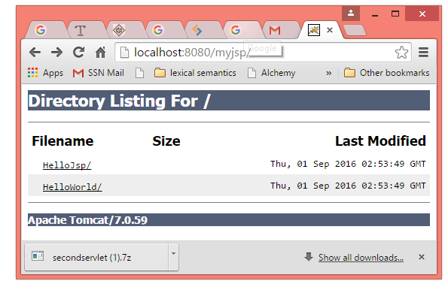
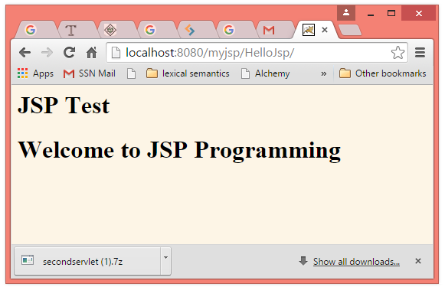
Output Snapshots - HelloJsp

Slide 7
JSP Example1 (using scriptlet tag)
Index.html
<html>
<body>
<form action="welcome.jsp">
<input type="text" name="uname"> <input type="submit" value="go"><br/>
</form>
</body>
</html>

Slide 8
JSP Example1 (using scriptlet tag)
welcome.jsp
<html>
<body>
<%
String name=request.getParameter("uname");
out.print("welcome "+name);
%>
</body>
</html>
Example Scriptlet tag
<% java source code %>

Slide 9
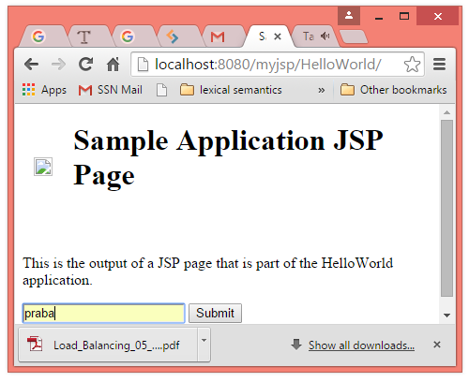
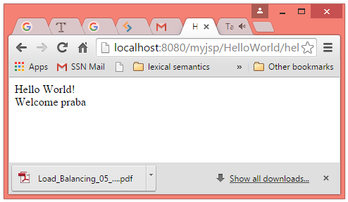
Output Snapshots

Slide 10
Implicit objects
Jsp implicit objects
created by the web container and available to all the jsp pages
Example
String str=request.getParameter()
out.println(str);
response. sendRedirect("http://www.google.com");
Object | Type
out | JspWriter
request | HttpServletRequest
response | HttpServletResponse
config | ServletConfig
application | ServletContext
session | HttpSession

Slide 11
Example for Session object
Index.html
<html>
<body>
<form action="welcome.jsp">
<input type="text" name="uname">
<input type="submit" value="go"><br/>
</form>
</body>
</html>
welcome.jsp
<html>
<body>
<%
String name=request.getParameter("uname");
out.print("Welcome "+name);
session.setAttribute("user",name);
<a href="second.jsp">second jsp page</a>
%>
</body>
</html>
second.jsp
<html>
<body>
<%
String name=(String)session.getAttribute("user");
out.print("Hello "+name);
%>
</body>
</html>

Slide 12
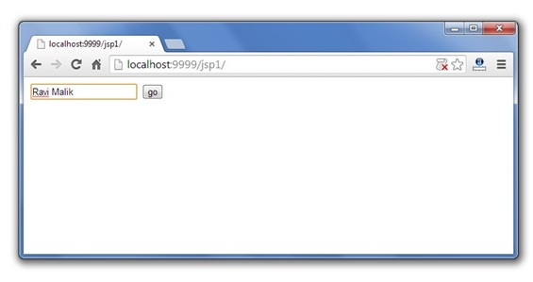
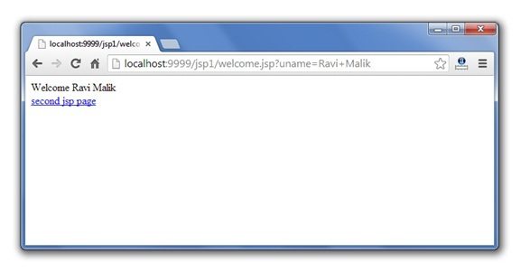
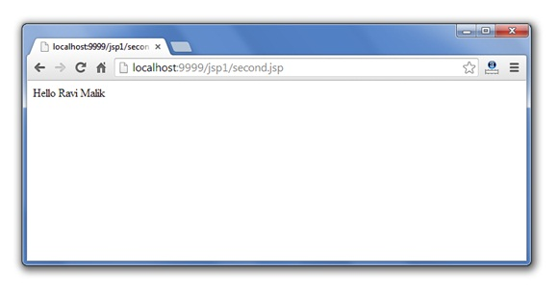
Output Snapshots

Slide 13
Expression Language
The Expression Language (EL) simplifies the accessibility of data stored in the Java Bean component, and other objects like request, session, application etc.
There are many implicit objects, operators and reserve words in EL.
${ expression }

Slide 14
Simple example of Expression Language that prints the name of the user
index.jsp
<form action="process.jsp">
Enter Name:<input type="text" name=“username" /><br/><br/>
<input type="submit" value="go"/>
</form>
process.jsp
Welcome, ${ param.username } or
Welcome, ${param[“username”]

Slide 15
Implicit objects in Expression Language
Implicit Objects | Usage
pageScope | it maps the given attribute name with the value set in the page scope
requestScope | it maps the given attribute name with the value set in the request scope
sessionScope | it maps the given attribute name with the value set in the session scope
applicationScope | it maps the given attribute name with the value set in the application scope
param | it maps the request parameter to the single value
paramValues | it maps the request parameter to an array of values
header | it maps the request header name to the single value
headerValues | it maps the request header name to an array of values
cookie | it maps the given cookie name to the cookie value
initParam | it maps the initialization parameter
pageContext | it provides access to many objects request, session etc.

